Slide 1
Weather Summary Classification
Presented By: Mohammad Amil Khan

Slide 2
PROBLEM STATEMENT
Develop a robust machine learning model to accurately classify weather summaries based on various meteorological factors. By utilizing this model, the company aims to improve weather forecasting accuracy, provide better insights to customers, and optimize weather-dependent operations.

Slide 3
OBJECTIVE
In this project, we explore a multiclass classification problem using a dataset containing diverse features related to weather conditions. The objective is to build robust predictive models to accurately classify weather summaries into categories such as Partly Cloudy, Overcast, Rain, Foggy, and Clear. By leveraging machine learning algorithms like Random Forest, XGBoost, and Logistic Regression, we aim to improve the accuracy and reliability of weather condition classification.

Slide 4
WORK FLOW
Step 1 | Import Libraries
Importing Required Libraries
Step 2 | Read Dataset
Gathering and organizing data to train machine learning models.
Step 3 | Dataset Overview
Basic and Descriptive Data Overview
Step 4 | EDA
Analyzing and visualizing data patterns to understand its characteristics
Step 5 | Data Preprocessing
Preparing and cleaning data to enhance its quality and suitability
Step 6 | Split Train And Test Data
Dividing the dataset into training and testing sets to evaluate
Step 7 | Model Training
Choosing a suitable machine learning algorithm and optimizing its parameters
Step 8 | Model Evaluation
Assessing the performance of a machine learning model using metrics
Step 9 | Conclusion
Conclusion of Models and EDA
Step 10 | Power BI Dashboard
Power BI Dashboard and it’s Conclusion

Slide 5
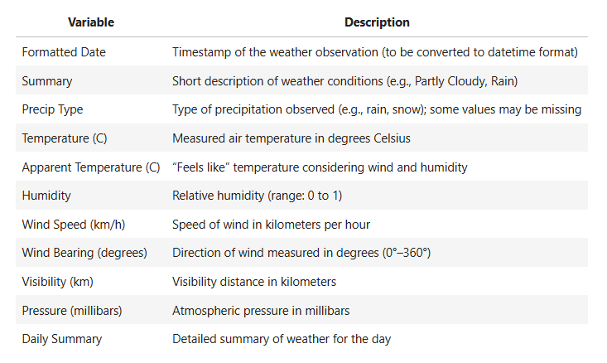
DATA COLLECTION & REFINEMENT
ROWS=96453
Columns=11
Target Variable = Summary
0 → Clear
1 → Foggy
2 → Mostly Cloudy
3 → Overcast
4 → Partly Cloudy

Slide 6
EXPLORATORY DATA ANALYSIS
Exploratory Data Analysis (EDA) helped us understand the data structure, find patterns, identify trends, and gain valuable insights from the dataset.
From EDA we analyze, the distribution of each features, checking the correlation between the features .
The datasets is clean, as there is no NULL no DUPLICATE VALUES and no OUTLIERS.

Slide 7
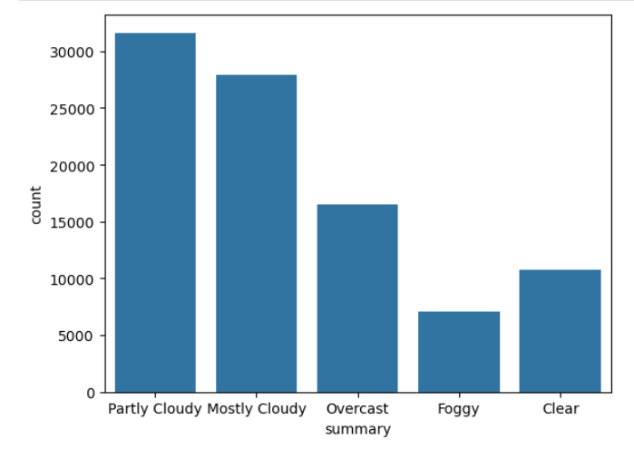
Distribution of Weather Conditions by Frequency
The most common weather condition is "Partly Cloudy," followed by "Mostly Cloudy." Less frequent conditions include "Foggy" and "Clear," with "Foggy" being the least common.

Slide 8
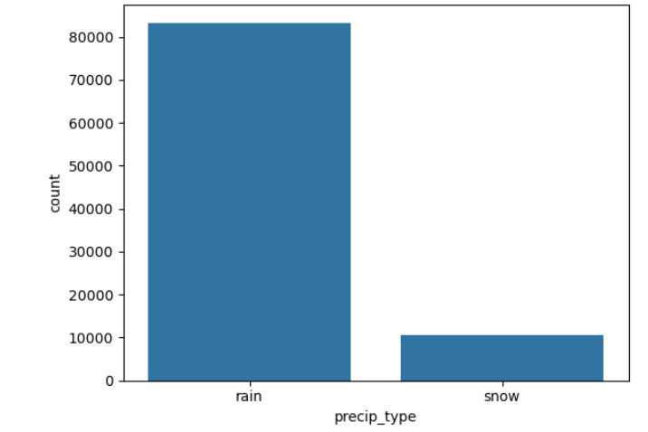
Precipitation Type Distribution: Rain vs Snow
Rain is significantly more common than snow, with over 80,000 occurrences compared to just above 10,000 for snow. This suggests a predominantly rainy climate in the dataset.

Slide 9
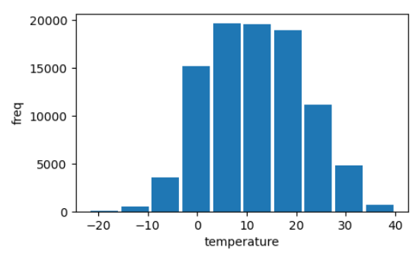
Temperature Distribution Across Observations
Most temperatures fall between 0°C and 20°C, indicating a moderate climate range. Extreme temperatures below -10°C or above 30°C are relatively rare.

Slide 10
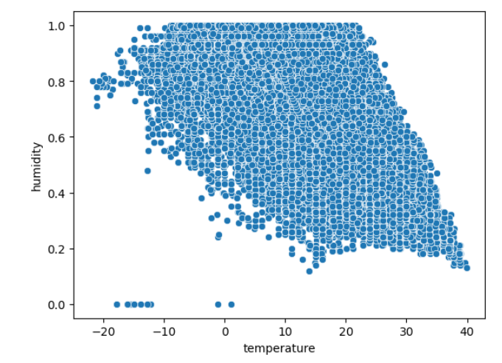
Relationship Between Temperature and Humidity
Humidity generally decreases as temperature increases, showing a negative correlation. Most high-humidity observations occur at lower to moderate temperatures.

Slide 11
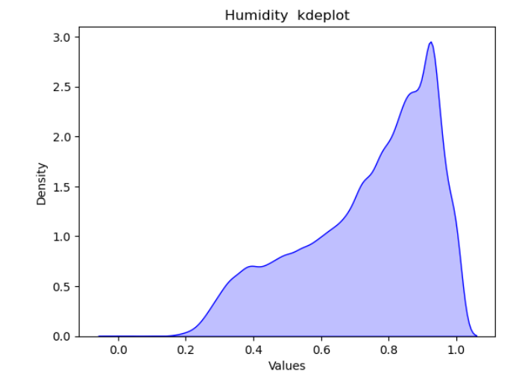
Humidity Distribution – KDE Plot
Humidity values are heavily concentrated around 0.9, indicating high humidity levels are most common. Very low humidity values are rare in the dataset.

Slide 12
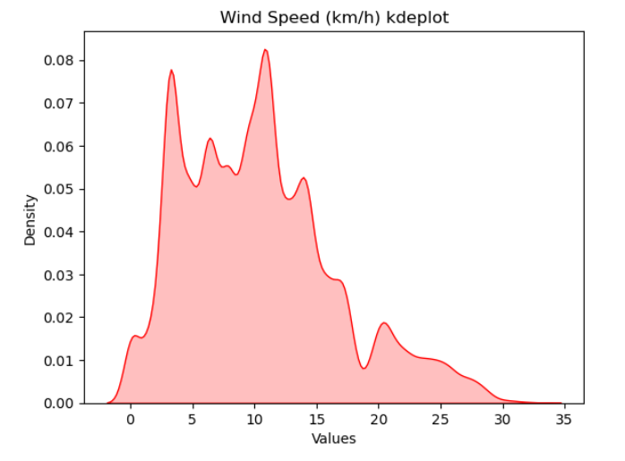
Wind Speed Distribution – KDE Plot
Most wind speeds fall between 5 and 15 km/h, with peaks around 4 km/h and 11 km/h. Very high wind speeds above 25 km/h are relatively rare.

Slide 13
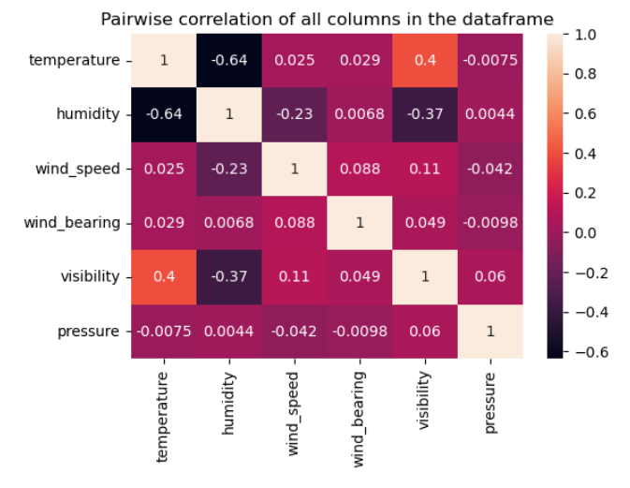
Heatmap of Pairwise Correlations Between Weather Variables
Temperature and humidity show a strong negative correlation (-0.64), while visibility has a moderate positive correlation with temperature (0.4). Most other variable pairs show weak or negligible correlations.

Slide 14
PREPROCESSING
Irrelevant Feature Removal: "daily_summary",
"formatted_date","apparent_temperature“
Duplicates Value: 24 duplicates found and removed.
Missing Value Treatment: 517 Missing values found dataset and removed.
Outliers Treatment: Checked outliers using IQR method for the continuous features and upon identifying outliers all outliers are removed.
Categorical Feature Encoding: Applied label encoding like columns ‘summary’ and 'precip_type'.
Feature Scaling: Standard scaling done after train and test split on numerical columns.

Slide 15
SPLITING THE DATA INTO X & Y
We divided the dataset into two parts: X and y.
"X" typically represents the independent Variables, and "y" represents the Dependent (target variable) that we want to predict or understand.
Random Over sampling is used
We use Random over sampling to oversample because the dataset is imbalanced.
TRAIN TEST SPLIT
We divided the data into training (80%) and testing (20%) sets.

Slide 16
MODEL SELECTION
Logistic Regression: logistic Regression is commonly used for binary classification problems. it's preferred because it provides a simple an efficient way to model the relationship between the independent variables and the probability of a certain outcome.
Random Forest Algorithm: Random Forest: Random Forest is a robust supervised algorithm suitable for both regression and classification tasks.
XGBoost: XGBoost (Extreme Gradient Boosting) is a powerful and efficient supervised learning algorithm based on gradient boosting, designed for both classification and regression tasks.

Slide 17

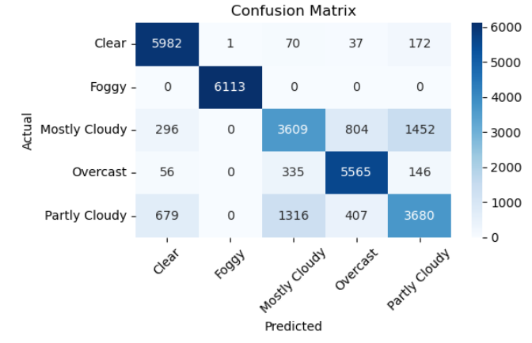
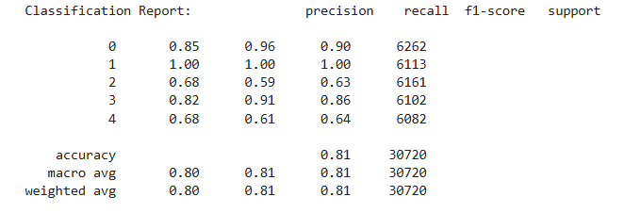
Random Forest Report

Slide 18
MODEL COMPARISON
MODEL | Accuracy | Precision | Recall | F1-Score
Logistic Regression | 55 | 53 | 55 | 53
XGBoost | 70 | 70 | 70 | 70
Random Forest Classifier | 81 | 80 | 81 | 80

Slide 19
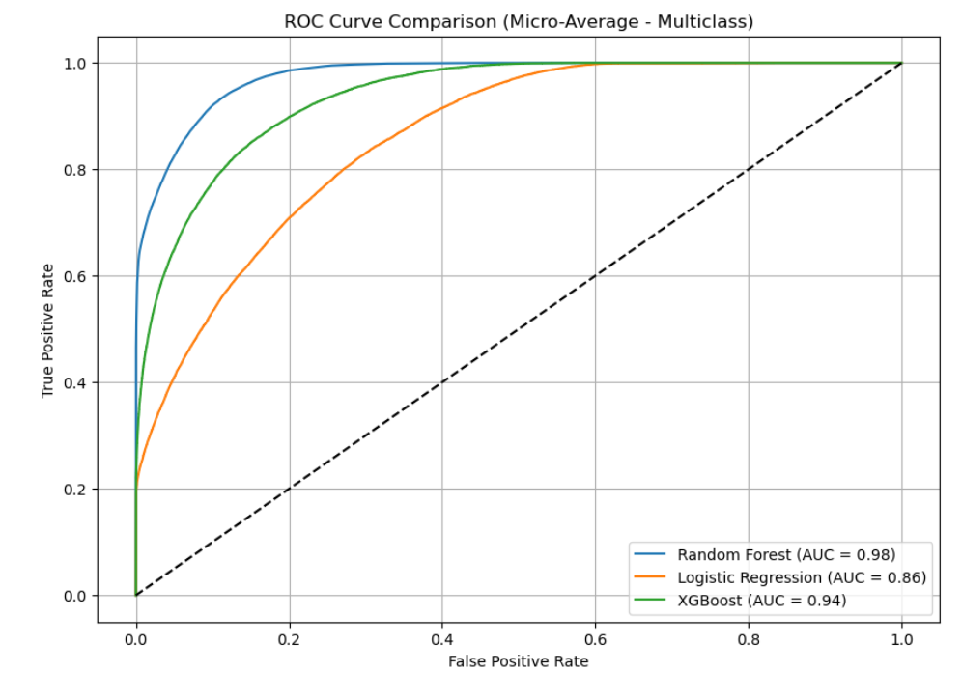
AUC-ROC CURVE FOR ALL MODELS
Random Forest stands out with the highest AUC of 0.98, showcasing exceptional classification accuracy and the ability to clearly distinguish between classes.
XGBoost follows closely with an AUC of 0.94, indicating strong predictive power and reliable performance across categories.
Logistic Regression lags behind with an AUC of 0.86, suggesting decent but comparatively lower discriminative capability than the ensemble-based models.
Conclusion: Random Forest outperforms both XGBoost and Logistic Regression in multiclass classification based on ROC-AUC.

Slide 20
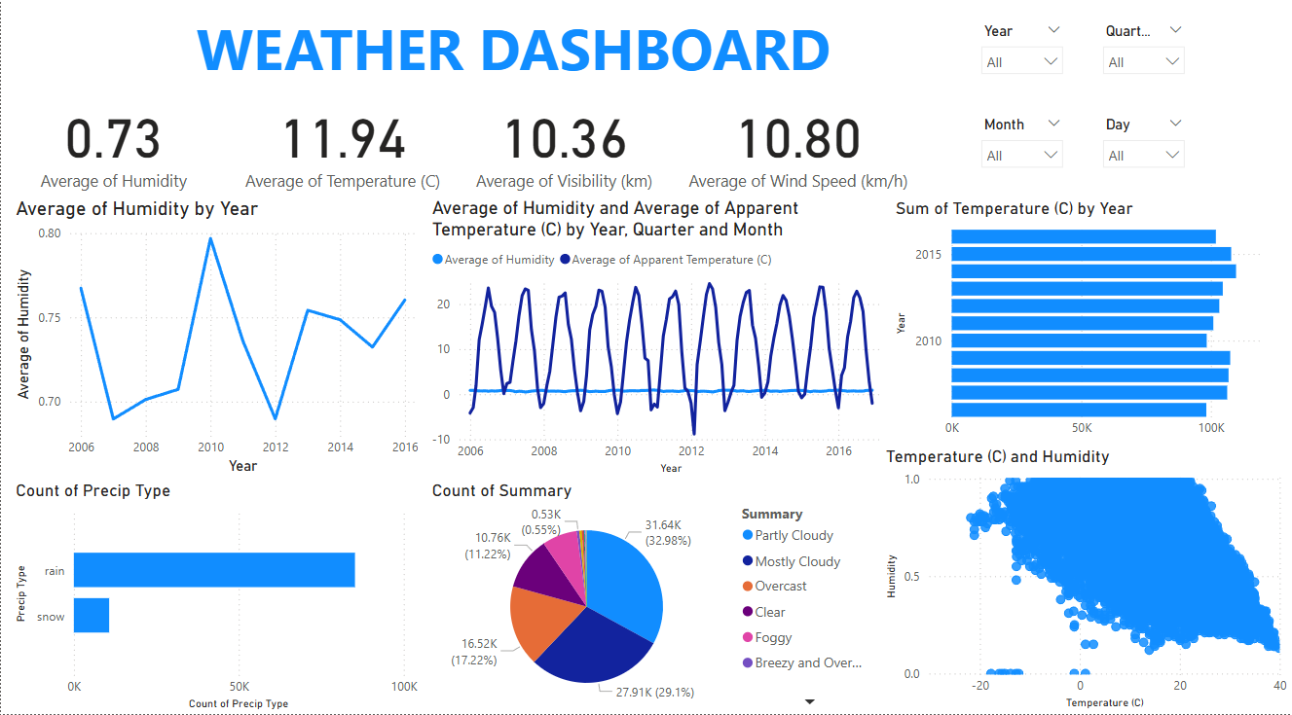

Slide 21
INSIGHTS
Overall Performance Metrics
• Avg. Temp: 11.94°C, Humidity: 0.73 – cool & humid climate • Visibility: 10.36 km, Wind: 10.80 km/h – clear & breezy
Weather Summary Breakdown
• Top conditions: Partly Cloudy (33%), Mostly Cloudy (29%), Overcast (17%) • Few clear or foggy days
Trends Over Time
• Humidity peaked in 2010 – indicates variability • Temp shows annual cycles – seasonal consistency
Temp & Humidity Correlation
• Inverse relation – as temp rises, humidity drops
Precipitation Analysis
• Rain is dominant; snow is rare • Suggests mild winters, rainy seasons

Slide 22
Conclusion
The dashboard reveals a generally cool and humid climate with consistent seasonal temperature cycles. Rain is the primary precipitation type, and cloud-heavy weather dominates the year. A clear inverse relationship exists between temperature and humidity levels.

Slide 23
Thank You!

